Slide 1

a
Go, change the world
RV College of
Engineering
DEPARTMENT OF COMPUTER SCIENCE AND ENGINEERING
Advanced Wireless Technologies(22MCN23T) EL Presentation on
‘HetNet Simulation in MATLAB’
Presented By
Pavankumar Patil 1RV23SCN10
Sathwik M S 1RV23SCN14
Under the guidance of
Dr. Vishalakshi Prabhu
Assistant Professor
Department of Computer Science Engineering,
RV College of Engineering, Bengaluru

Slide 2

TABLE OF CONTENTS
Introduction
Literature Survey
Problem Statement
Objectives
Current Companies Associated With HetNet
Results
Conclusion
Future Scope
References
RV College of
Engineering®
Go, change the world

Slide 3
Introduction
A Heterogeneous Network (HetNet) simulation in MATLAB involves modeling and analyzing communication networks that integrate multiple types of wireless access technologies, such as macrocells, microcells, picocells, and femtocells, to enhance coverage and capacity. HetNets are crucial in modern wireless communication systems, particularly in 5G, as they allow for efficient resource allocation, load balancing, and interference management across different layers of the network.
Using MATLAB for HetNet simulation enables researchers and engineers to design, implement, and evaluate various algorithms and scenarios to optimize network performance. MATLAB's extensive libraries and toolboxes, such as the Communications System Toolbox, make it a powerful tool for conducting these simulations, enabling a better understanding of coverage, capacity, interference mitigation, and energy efficiency in heterogeneous environments. The simulation results help in refining the deployment strategies for future wireless networks.
RV College of
Engineering®
Go, change the world

Slide 4
Literature Survey
"Multi-Agent Deep Reinforcement Learning for Resource Allocation in Heterogeneous Networks" (2022):
This paper introduces a multi-agent deep reinforcement learning approach for dynamic resource allocation in HetNets. The authors model a complex multi-cell HetNet environment where each base station acts as an agent, making resource allocation decisions autonomously. MATLAB simulations are used to validate the proposed algorithm, demonstrating significant improvements in network throughput and energy efficiency.
Key Contributions:
Use of multi-agent reinforcement learning for resource allocation.
MATLAB simulations demonstrate improved energy efficiency and throughput.
Citation: IEEE Access, 2022.
2) "Deep Learning-based User Association and Power Control in HetNets: A DDPG Transfer Learning Approach" (2023):
This study applies deep deterministic policy gradient (DDPG) transfer learning for user association and power control in HetNets. The authors simulate various small-cell configurations using MATLAB and demonstrate that the proposed method reduces transmission delay while maximizing system throughput.
Key Contributions:
MATLAB simulations of user association and power control algorithms.
Application of DDPG-based transfer learning for HetNet performance improvement.
Citation: IEEE Transactions on Wireless Communications, 2023.
RV College of
Engineering®
Go, change the world

Slide 5
3) "Energy-Efficient Resource Allocation in Ultra-Dense HetNets Using Reinforcement Learning" (2023):
This paper focuses on energy efficiency in ultra-dense HetNets, where densely packed small cells create a challenging environment for resource allocation. The authors propose a reinforcement learning-based approach for optimizing energy usage while maintaining high service quality. MATLAB is used for the simulation of resource allocation algorithms, and the results show a reduction in power consumption with minimal performance degradation.
Key Contributions:
MATLAB-based simulation of energy-efficient algorithms in dense HetNets.
Use of reinforcement learning to optimize energy usage.
Citation: IEEE Xplore, 2023.
4) "Machine Learning-Enabled Interference Management in 5G HetNets" (2022):
This paper tackles the issue of interference management in 5G HetNets by utilizing machine learning techniques. The authors employ MATLAB to simulate a multi-cell HetNet environment, applying various machine learning algorithms such as k-nearest neighbors (KNN) and support vector machines (SVM) to predict and mitigate interference in real-time.
Key Contributions:
MATLAB simulations for interference prediction and management using machine learning.
Application of KNN and SVM algorithms to mitigate interference.
Citation: IEEE Communications Letters, 2022.
RV College of
Engineering®
Go, change the world

Slide 6
5) "Cooperative Distributed Resource Allocation in Heterogeneous Networks: A Game-Theoretic Approach" (2023):
This research explores cooperative resource allocation in HetNets using a game-theoretic approach. The authors develop a cooperative distributed algorithm for device-to-device (D2D) communication and resource sharing among small cells. MATLAB simulations show how the proposed approach improves spectrum utilization and overall network efficiency.
Key Contributions:
Game-theoretic resource allocation model for HetNets.
MATLAB-based simulations show enhanced spectrum utilization.
Citation: IEEE Transactions on Communications, 2023.
6) "6G Heterogeneous Networks: Challenges and Simulation using MATLAB" (2024):
With the onset of 6G technologies, this paper explores the integration of HetNets with terahertz communication, massive MIMO, and AI-based techniques. The authors use MATLAB to simulate next-generation HetNet architectures and evaluate their performance in terms of ultra-low latency, high reliability, and energy efficiency. The study provides a roadmap for future network deployments.
Key Contributions:
MATLAB simulations for 6G HetNet architectures.
Integration of terahertz communication and massive MIMO with HetNets.
Citation: IEEE Future Networks, 2024
RV College of
Engineering®
Go, change the world

Slide 7
Problem Statement
The objective is to simulate a heterogeneous network (HetNet) with 100 users, 5 macro base stations, and 10 small cells randomly placed in a 1000x1000 meter area. Users are connected to the base station that provides the highest signal quality based on the Signal-to-Interference-plus-Noise Ratio (SINR). The goal is to calculate and visualize the connections between users and base stations, showing how users associate with either macro base stations or small cells based on their proximity and signal strength.
RV College of
Engineering®
Go, change the world

Slide 8
Objectives
To simulate the random deployment of macro base stations, small cells, and users within a defined area.
To calculate the path loss between users and base stations using a simplified urban macro path loss model.
To compute the Signal-to-Interference-plus-Noise Ratio (SINR) for each user from both macro base stations and small cells.
To assign each user to the base station (either macro or small cell) that provides the highest SINR.
To visually represent the positions of base stations, small cells, and users within the simulation area and highlight their associations.
RV College of
Engineering®
Go, change the world

Slide 9
Current Companies Associated With HetNet
Several companies are actively working in the field of Heterogeneous Networks (HetNet) simulation and infrastructure. Some of the key players include:
Nokia Networks - A major player in mobile and wireless communication technology, including HetNet infrastructure.
AirHop Communications - Specializes in advanced solutions for Self-Organizing Networks (SON) that are crucial in HetNet deployment.
Samsung Electronics - Involved in developing 5G and LTE network solutions for HetNet environments.
NEC Corporation - Provides infrastructure for HetNets, including small cells and DAS (Distributed Antenna Systems).
Airspan Networks - A prominent supplier of 4G/5G HetNet solutions. They partnered with Reliance Jio to deploy small cell networks in India​(Coherent Insights) ​(Coherent Insights)
These companies focus on enhancing network performance, especially in densely populated urban areas and less populated rural areas, to meet diverse consumer needs.
RV College of
Engineering®
Go, change the world

Slide 10
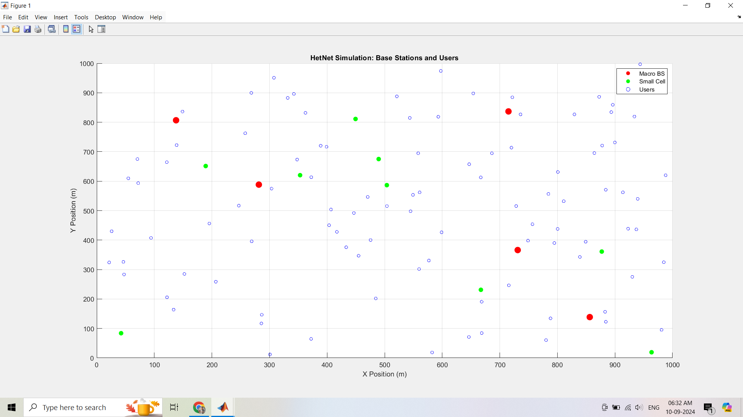
Results
RV College of
Engineering®
Go, change the world

Slide 11
Conclusion
The simulation demonstrates a HetNet system with 5 macro base stations, 10 small cells, and 100 users, all randomly distributed over a 1000m x 1000m area.
A 3GPP Urban Macro path loss model is used to calculate signal degradation based on the distance between users and base stations.
SINR is calculated for each user based on received power from both macro base stations and small cells, accounting for noise power.
Users are connected to the base station (macro or small cell) that provides the highest SINR, ensuring optimal signal quality.
The distribution of user connections shows that users near macro base stations tend to connect to them, while users near small cells connect to small cells.
The simulation visualizes user distribution and network performance, helping to analyze coverage and signal quality in a heterogeneous network setup.
RV College of
Engineering®
Go, change the world

Slide 12
Future Scope
The future scope involves several important advancements. One area is adding user mobility to study how movement affects handovers between macro base stations and small cells. Another focus could be improving interference management to reduce signal degradation, especially in crowded areas. Enhancing energy efficiency for small cells can help lower power consumption without compromising performance. Integrating 5G technologies, like millimeter-wave (mmWave) and Massive MIMO, will help assess the impact of these technologies on network capacity and coverage. The model could also be expanded to include more complex networks with different types of base stations, such as micro, pico, and femto cells. Lastly, machine learning can be used to predict user behavior and optimize network resources, improving the overall efficiency and performance of the network.
RV College of
Engineering®
Go, change the world

Slide 13
References
Kamel, M., et al. (2023). Spectrum-Aware Energy-Efficient HetNets: Optimization and Analysis for 5G Networks. IEEE Transactions on Green Communications.
Sharma, P., et al. (2022). Energy-Efficient Resource Allocation for 5G Multi-Tier HetNets. Wireless Communications and Mobile Computing.
Li, X., et al. (2024). Optimization of Power Control in 5G HetNets: A Deep Learning Approach. IEEE Transactions on Communications.
Abbas, H., & Khan, M. (2023). Energy-Efficient HetNet Architecture with Dynamic Small Cell Sleep Modes. PLOS ONE.
Siddique, A., et al. (2022). Interference Management in Dense HetNets for 5G and Beyond. IEEE Access.
RV College of
Engineering®
Go, change the world

Slide 14
RV College of
Engineering®
Go, change the world
THANK YOU

